Slide 1
Perceiver & Perceiver IO Implementation and Experimental Analysis
Francesco Gigli · Corso Vignoli
Università degli Studi di Firenze | Course B031278 — Deep Learning

Slide 2
1
Introduction
2
Perceiver
3
Experiments: Perceiver
4
Perceiver IO
5
Experiments: Perceiver IO
6
Conclusion
F. Gigli C. Vignoli Perceiver & Perceiver IO

Slide 3
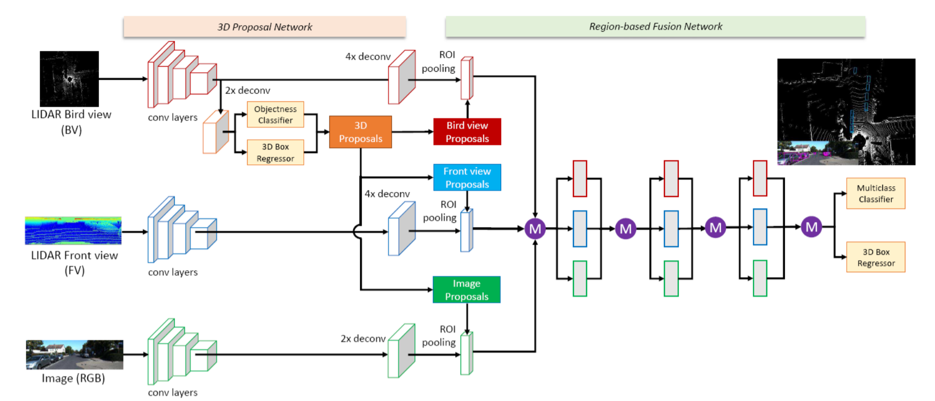
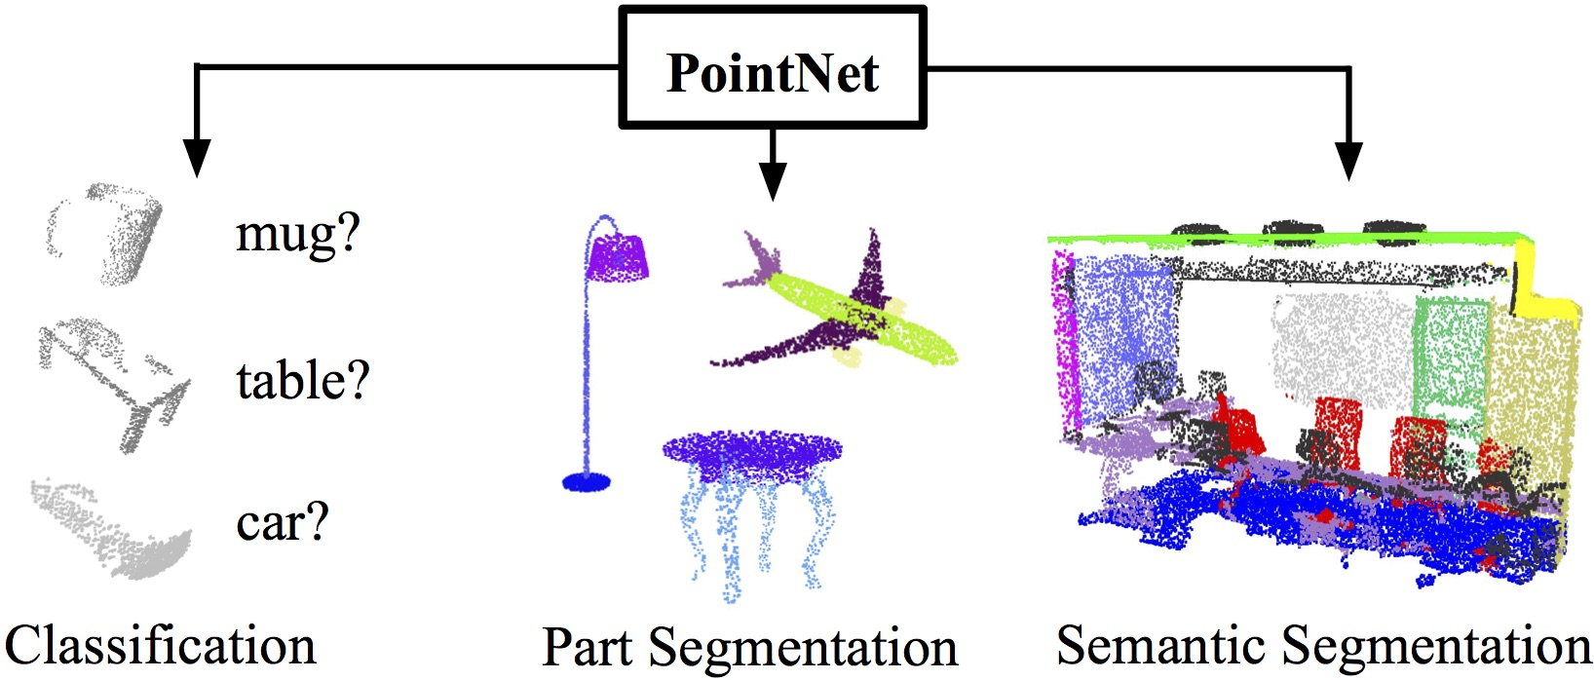
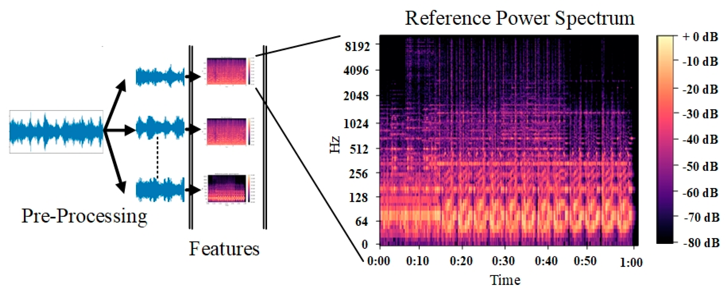
The Problem: Modality-Specific Architectures
One modality, one architecture
Images
→ CNNs
Text
→ Transformers
Audio
→ RNNs / 1D-CNN
Point Clouds
→ PointNet
Each data type is usually paired with a dedicated model and domain-specific assumptions about structure.
Can one architecture handle arbitrary inputs?
F. Gigli C. Vignoli Perceiver & Perceiver IO

Slide 4
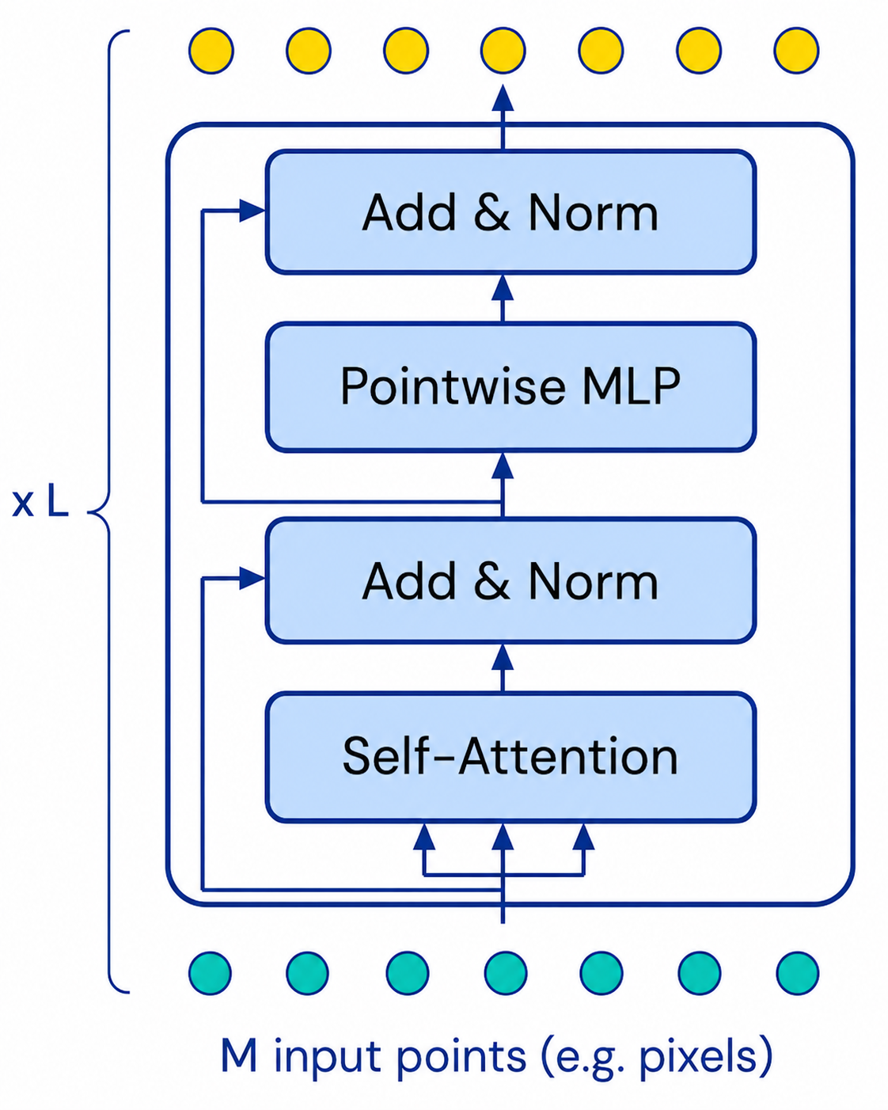
The Problem: Scaling bottleneck
A Transformer layer contains self-attention and a pointwise MLP.
Self-attention: compares all token pairs → cost $O$($M^{2}·L$)
Pointwise MLP: processes each token independently → scales linearly with $O\left(M·L\right)$
Input representation | M
16×16 image patches | 256
Raw 224×224 pixels | 50,176
!
The MLP scales linearly, but self-attention is the true bottleneck.
Raw pixels make standard attention impractical.
Can one architecture handle arbitrary inputs without quadratic cost?
F. Gigli C. Vignoli Perceiver & Perceiver IO

Slide 5
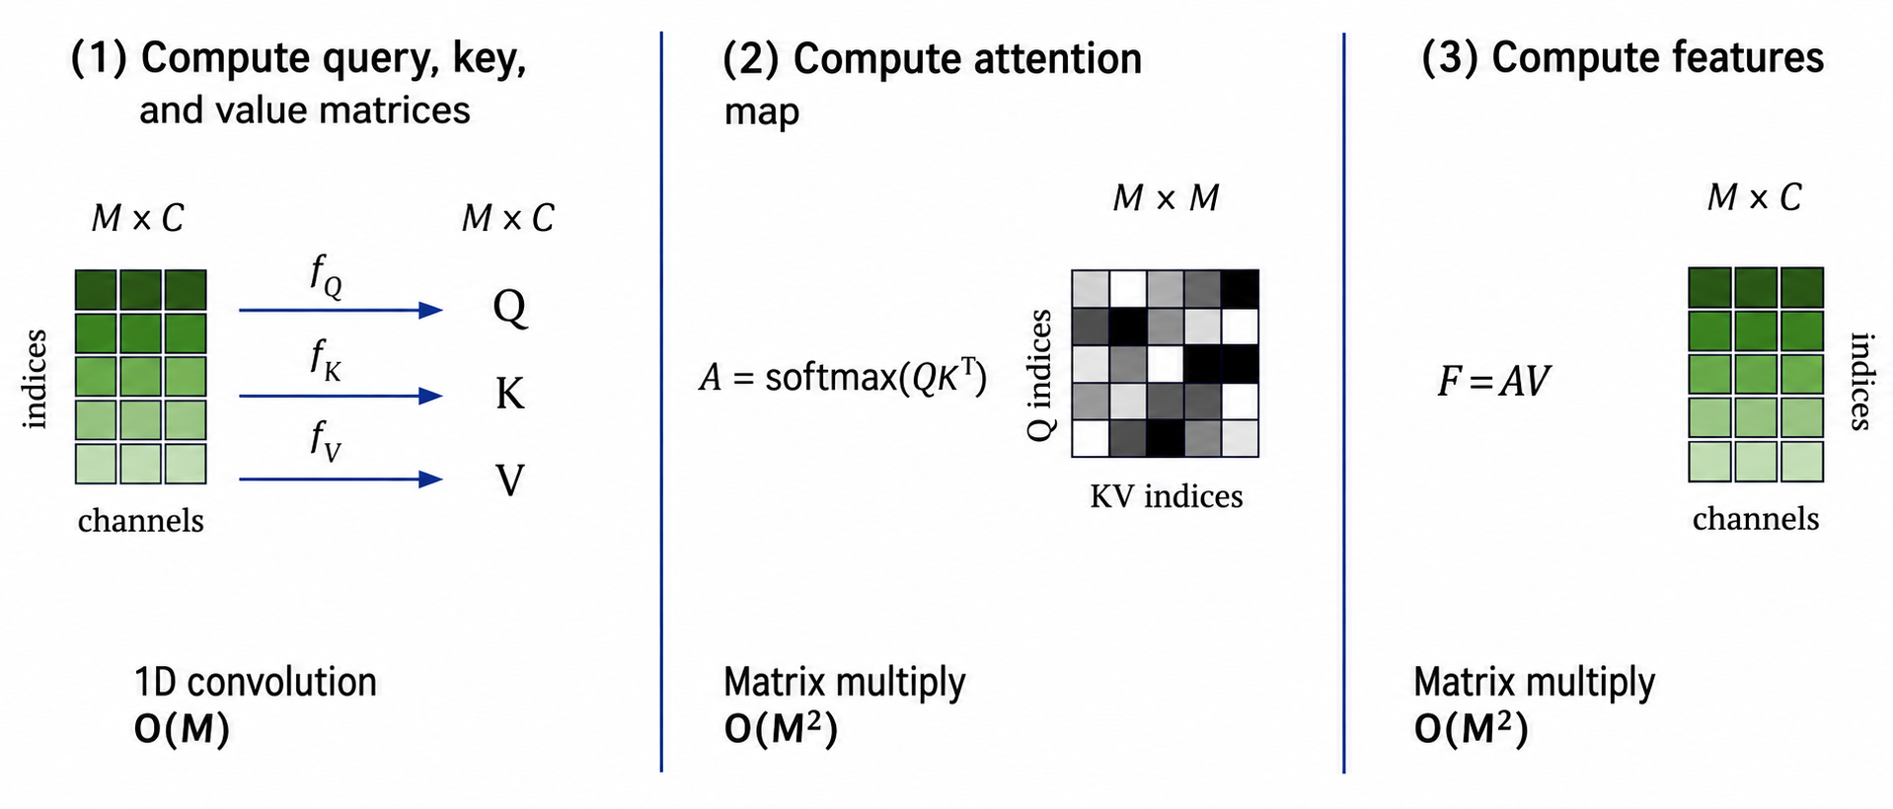
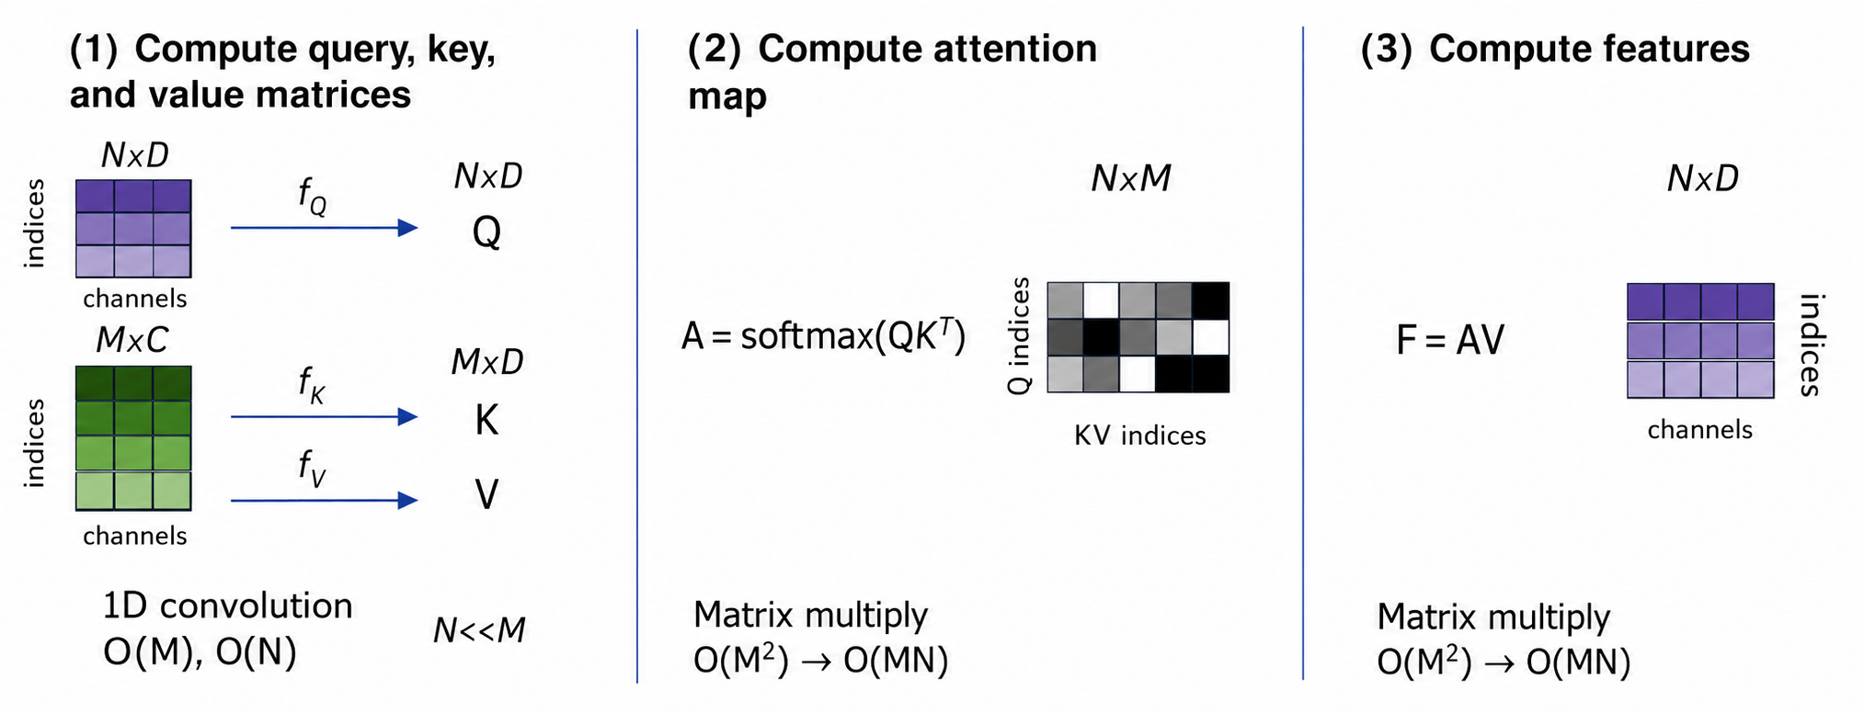
The Perceiver Solution
Standard self-attention
Perceiver cross-attention
O(M)
O(M²)
O(M²)
N(N) + O(M)
O(MN)
O(MN)
Self-attention: O(M²) → Cross-attention: O(MN)
F. Gigli C. Vignoli Perceiver & Perceiver IO

Slide 6
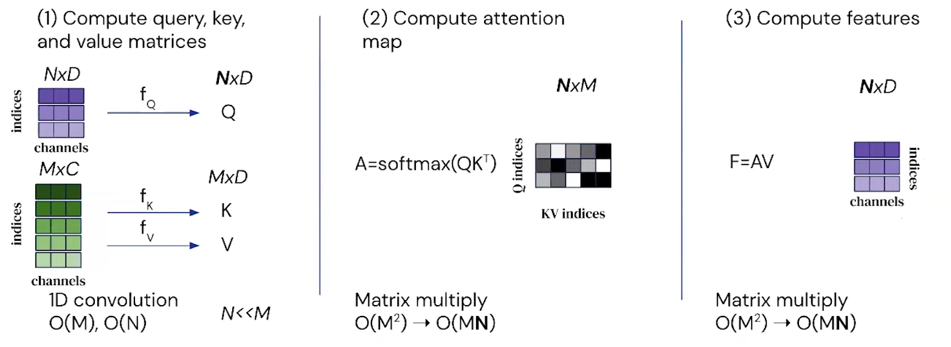
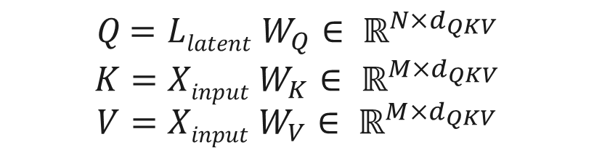
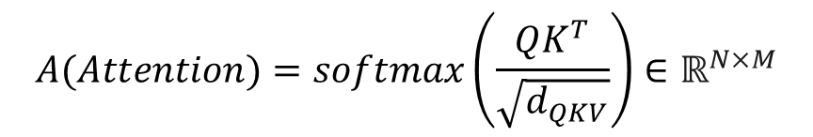

Cross-Attention
$Q$ $=Z W_{Q}∈ ℝ^{N×d_{k}}$
$$K=X W_{K}∈ ℝ^{M×d_{k}}$$
$$V=X W_{V}∈ ℝ^{M×d_{k}}$$
$$A(Attention)=softmax\left(\frac{QK^{T}}{\sqrt{d_{k}}}\right)∈ℝ^{N×M}$$
$F=CrossAttn(Q,K, V)$= $A∙V$ $∈$ $ℝ^{N×d_{k}}$
Cross-attention uses the latent array to read information from the input sequence. The output (F) is a compact latent representation that will be refined by the latent transformer.
F. Gigli C. Vignoli Perceiver & Perceiver IO

Slide 7
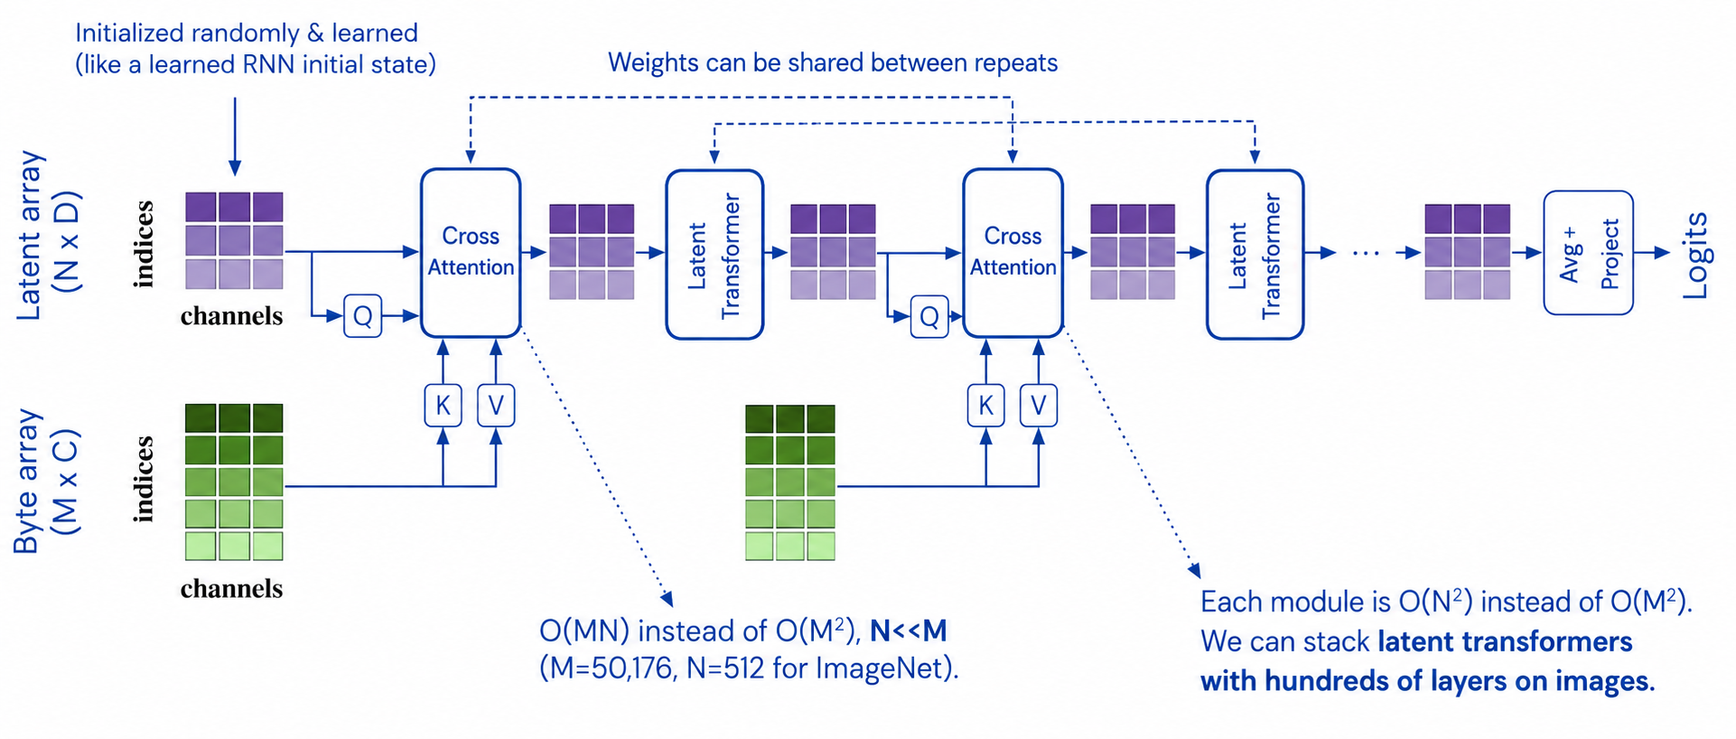
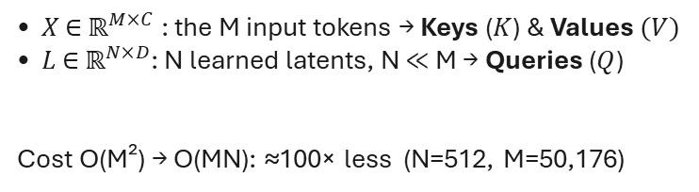
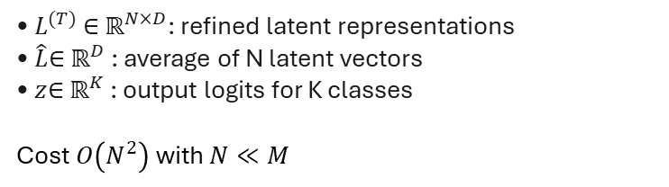
Perceiver Architecture
Encode and process
Latent core and output
• $X$ ∈ ${\text{ℝ}}^{M×C}$: the M input tokens → Keys ($K$) & Values $(V)$
• $L$ ∈ ${\text{ℝ}}^{N×D}$: N learned latents, N ≪ M → Queries ($Q$)
Cost O(M²) → O(MN): ≈100× less (N=512, M=50,176)
• $L^{(T)}$ ∈ ${\text{ℝ}}^{N×D}$: refined latent representations
• $\hat{L}$∈ ${\text{ℝ}}^{D}$: average of N latent vectors
• $z$∈ ${\text{ℝ}}^{K}$: output logits for K classes
Cost $O\left(N^{2}\right)$ with $N≪M$
F. Gigli C. Vignoli Perceiver & Perceiver IO

Slide 8
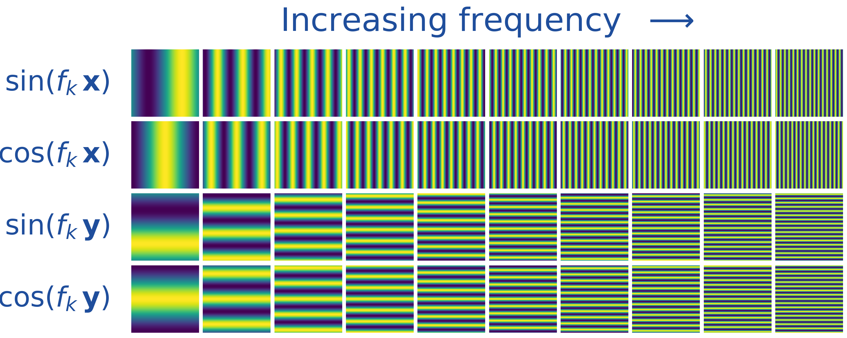
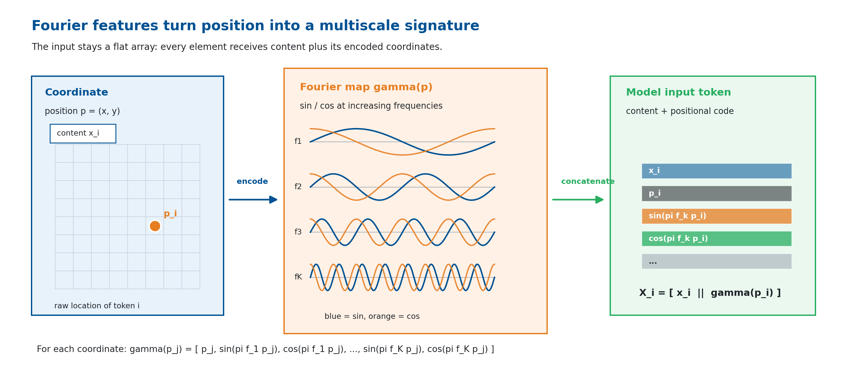
Fourier Positional Encoding
The Perceiver sees a flat array and attention is permutation-invariant, so position must be encoded into each input token.
$X_{i}=\left[x_{i}∥ γ\left(p_{i}\right)\right]$ — content ∥ Fourier position code
General recipe
Input seen by attention
• Domain coordinates: images (u, v), point clouds (x, y, z), text index t
• Sin/cos bands up to the Nyquist frequency — above it points alias and blur
• Sample the spectrum densely: more bands help (vs NeRF’s few)
• The array stays flat; each token is enriched before projection
• Position is concatenated to content, not added as in language
• Concatenation works better when content is dense (vision)
F. Gigli C. Vignoli Perceiver & Perceiver IO

Slide 9
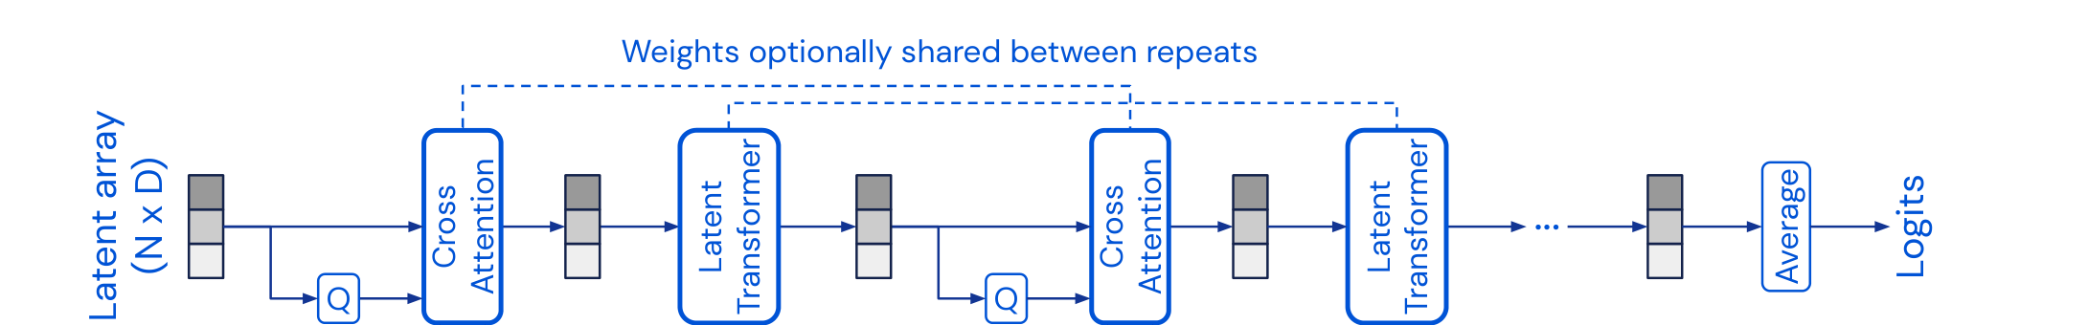
Latent Transformer & Weight Sharing
Once information is in the latent array, depth is spent by reusing the same processor on a compact state.
Weight sharing
Why it matters
• The same Latent Transformer block $B_{θ}$ is reused at every repeat, sharing parameters $θ$
• Unrolling depth behaves like an RNN over the latent state: $Z^{(t+1)}=B_{θ}(Z^{(t)})$
• Most useful in low-data regimes (e.g. ImageNet), where it curbs overfitting
• Iterative refinement without a new processor at each step
• Parameter count stays fixed as depth grows
• Computation stays in the compact N-slot latent space
• Optional repeated cross-attends re-read the input — powerful but heavy, no longer the default
F. Gigli C. Vignoli Perceiver & Perceiver IO

Slide 10
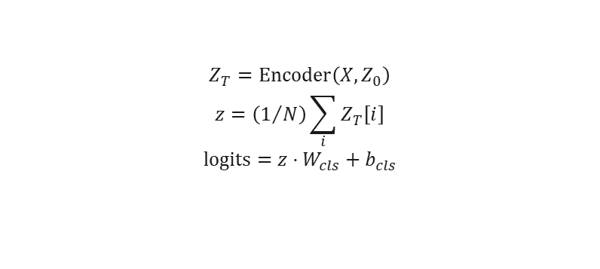
Original Perceiver Output: Pooling Classifier
The original Perceiver has exactly one way out: average the latents, then project. That fixes the output to a single label.
$$Z_{T}=\text{Encoder}\left(X,Z_{0}\right)$$
$$z=\left(1/N\right)\sum_{i}{Z_{T}\left[i\right]}$$
$$\text{logits}=z·W_{cls}+b_{cls}$$
What pooling does
Where the FFN and sharing sit
• The N latent vectors are averaged into one, so the output size no longer depends on the input
• That single vector is projected to the class logits
• It suits classification and nothing else: there is no way to ask for a mask or a sequence
• Each latent block is pre-norm attention, a residual, an FFN, then another residual
• The FFN adds the non-linearity once attention has mixed the slots
• Weight sharing reuses the same processor at every iteration — except the first block, which keeps its own
F. Gigli C. Vignoli Perceiver & Perceiver IO

Slide 11
Computational Complexity Analysis
A Transformer pays for every pair of input tokens. The Perceiver pays once to read the input, then works on a fixed number of latents.
Model | Self-Attn | Cross-Attn | Total
Standard Transformer | $O(M^{2}d)$ | — | $O(M^{2}d·L)$
Perceiver | $O(N^{2}d)$ | $O(MNd)$ | $O((MN+N^{2}L)d)$
Symbols
What it buys
$M$ — number of input elements $N$ — number of latent slots ($N≪M$) $L$ — number of latent processing layers $d$ — hidden channel dimension
• The whole input is read once, through cross-attention
• Every repeat after that stays inside the N latent slots
• With N fixed, depth stops depending on how long the input is
• That is why 1,024 pixels and 512 bytes end up costing the same
F. Gigli C. Vignoli Perceiver & Perceiver IO

Slide 12
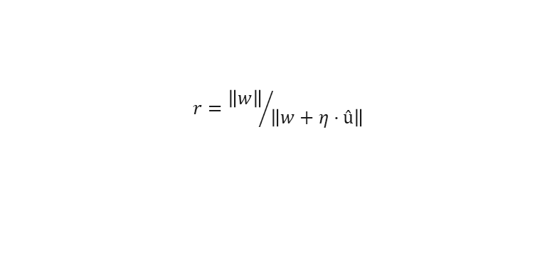
GELU Activation & LAMB Optimizer
Two choices inherited from the paper: a smooth activation, and an optimiser built for batches far larger than ours.
GELU — Gaussian Error Linear Unit
LAMB — Layer-wise Adaptive Moments
$$\text{GELU}\left(x\right)=x·Φ\left(x\right)≈x·σ\left(1.702x\right)$$
$$r={\left\|w\right\|}/{\left\|w+η·û\right\|}$$
• A smooth activation, standard across Transformers
• It lets a small negative gradient keep flowing instead of clipping it to zero
• A per-layer trust ratio rescales each update
• It is what keeps very large batches from diverging
Why LAMB here, and what it cost us
• The cross-attention bottleneck produces high-variance gradients and plain Adam destabilises with large batches, so the paper uses LAMB
• At batch 64 that advantage disappears — and LAMB is exactly what makes the latent init scale so dangerous: at 1.0 the run collapses to 52.08%
F. Gigli C. Vignoli Perceiver & Perceiver IO

Slide 13
Implementation
The mechanism is the paper's, unchanged. What differs is scale, data budget and hardware.
Aspect | Paper implementation | Project code
Core model | Cross-attention into learned latents, latent self-attention, FFN, weight sharing | Same modules; weight sharing exposed as an ablation switch
Model scale | Large vision/language: up to 512×1024 latents, 201M-param IO | CIFAR-10 96×384; ModelNet40 / text 128×512
Data setting | ImageNet, ModelNet40, large language pretraining corpora | CIFAR-10, ModelNet40, WikiText-103 byte-MLM, GLUE fine-tuning
Training budget | Distributed accelerators, batches up to 512–1024 | Single-GPU, batches 32–64, LAMB retained
Practical additions | Minimal regularization in the reference setup | Validation split carved from train, fixed seed, attention-map extraction, declarative run registry
F. Gigli C. Vignoli Perceiver & Perceiver IO

Slide 14
Implementation Differences from the Paper
Every difference from the paper follows from one GPU instead of 512 TPU cores. The architecture itself is untouched.
Choice | Original paper (ImageNet) | This project
Input tokenization | Raw pixels, no patching (M = 50,176) | Raw pixels, no patching (CIFAR-10, M = 1,024)
Latent array N × D | 512 × 1024 | 96 × 384 (CIFAR-10); 128 × 512 (ModelNet40, text)
Cross-attend iterations T | 8 | 4 (CIFAR-10); 2 (ModelNet40); 1 (text)
Positional encoding | 2D Fourier, K = 64 bands/axis (258 dims) | 2D Fourier, K = 64 bands/axis (258 dims) — identical
Weight sharing | On by default (shared across T) | Exposed as an ablation switch (on/off)
Parameters | 30–200M+ | 10.2M (CIFAR-10) · 23.3M (ModelNet40) · 18.9M (IO text)
Cross-attention bottleneck, weight-shared latent transformer, then mean pooling or an output-query decoder. The input is raw pixels, exactly as in the paper.
F. Gigli C. Vignoli Perceiver & Perceiver IO

Slide 15
CIFAR-10: Experimental Setup
Goal — validate the Perceiver on raw pixels: one token per pixel, no patching, no convolutional assumptions.
Hyperparameter | Value
Latent array (N × D) | 96 × 384
Cross-attn stages (T) | 4, interleaved, shared
Transformer blocks (L) | 4 (shared)
Attention heads | 1 cross · 8 self
Input tokens (M) | 1,024 raw pixels
Dropout | 0.0
Optimizer / LR | LAMB · 0.004
LR schedule | MultiStep [84, 102, 114]
Batch size | 64
Epochs | 120 (no early stopping)
Total parameters | 10.18M
What we varied
• Positional encoding: Fourier, learned, or none at all
• How many cross-attends, and where they sit
• Weight sharing and the latent transformer
• Fourier bands, maximum frequency, latent init scale
• And three identical runs, to measure the noise
How the data reaches the model
• A 32×32 image becomes 1,024 tokens, one per pixel
• The Fourier encoding adds 258 features: each token carries 261 numbers
• Augmentation is RandAugment alone, two ops at magnitude 9
• 5,000 training images are held out as the validation split
F. Gigli C. Vignoli Perceiver & Perceiver IO

Slide 16
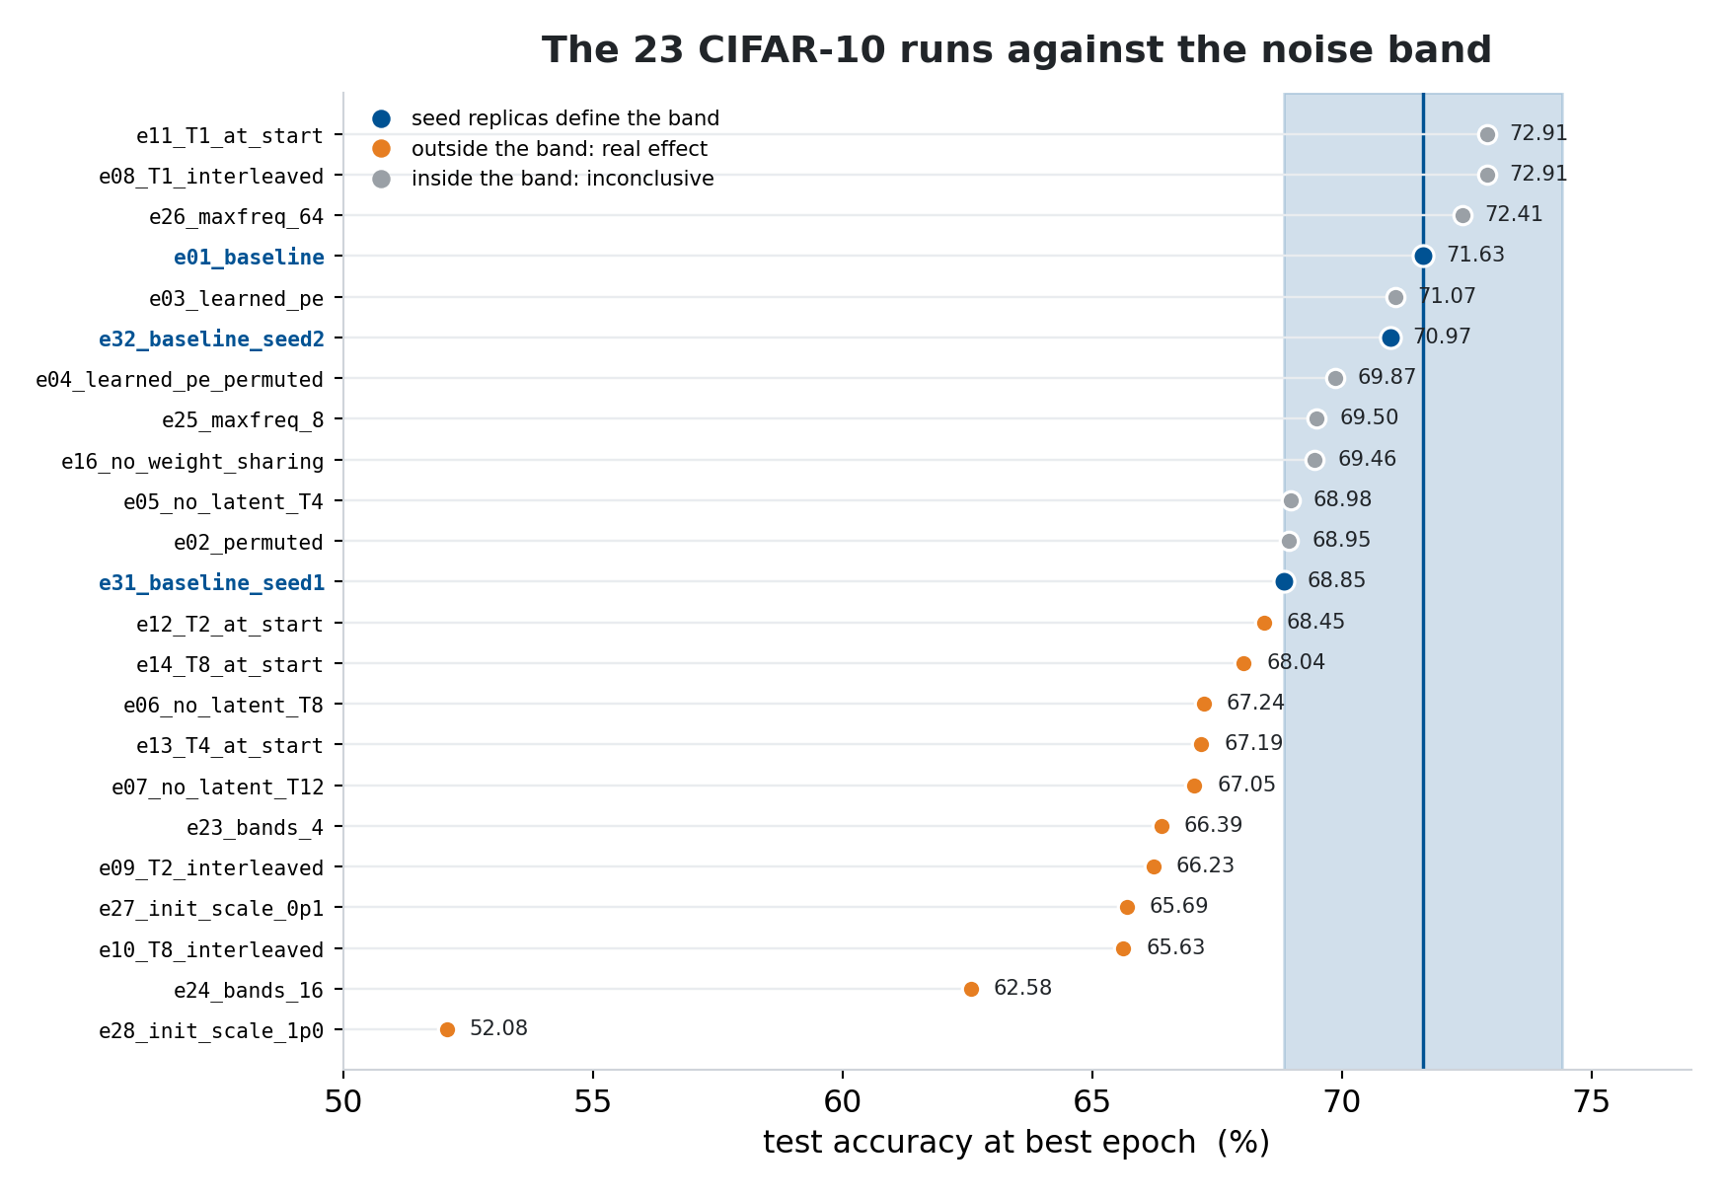
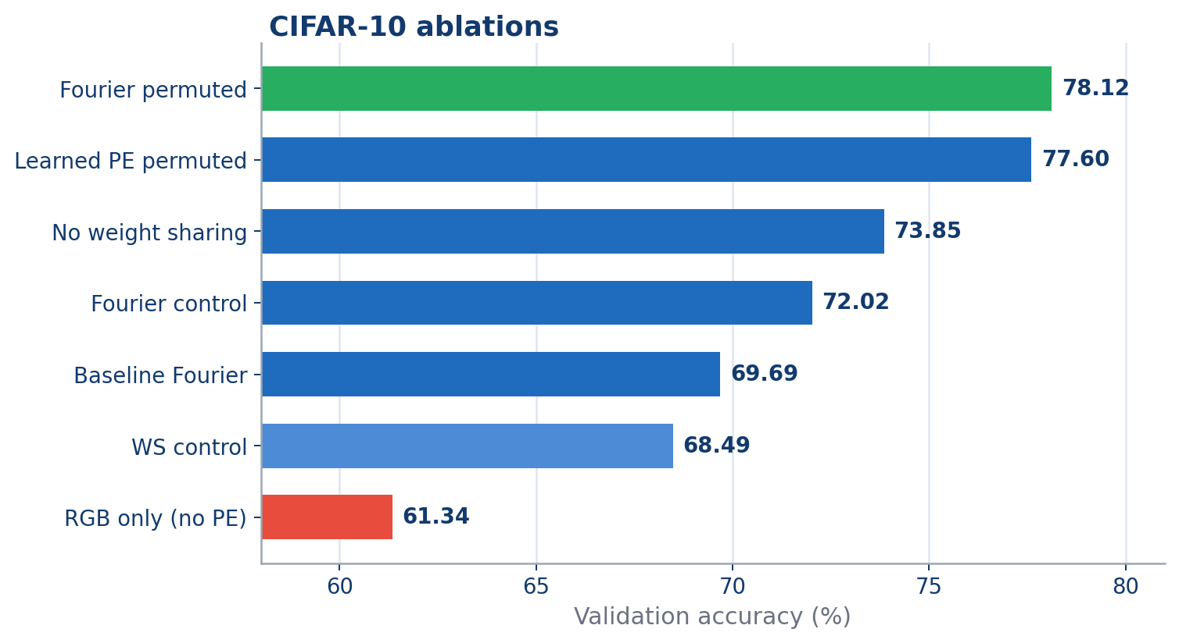
CIFAR-10: Ablation Accuracy
Twenty-four runs on CIFAR-10. The best reaches 72.91%, the baseline 71.63% — and most of the gaps between them are smaller than the noise.
What moved the number
• Removing the positional encoding: −39.27 points
• Latent init scale at 1.0: −19.55
• Sixteen Fourier bands instead of 64: −9.05
What did not
• One cross-attend instead of four gains 1.28 points, which is inside the 2.78-point band
• Every figure comes from logs/<run>/results.json, at the epoch chosen on validation
F. Gigli C. Vignoli Perceiver & Perceiver IO

Slide 17
CIFAR-10: Ablation Matrix
Ranked by accuracy, with the verdict computed against the noise band — not decided by eye.
Run | Change | Params | Acc. | vs e01 | Verdict
e08_T1_interleaved | T = 1 | 8.65M | 72.91% | +1.28 | inside band
e26_maxfreq_64 | f_max 64 | 10.18M | 72.41% | +0.78 | inside band
e01_baseline | — reference | 10.18M | 71.63% | — | —
e16_no_weight_sharing | no sharing | 31.46M | 69.46% | -2.17 | inside band
e02_permuted | permuted | 10.18M | 68.95% | -2.68 | inside band
e24_bands_16 | 16 bands | 9.63M | 62.58% | -9.05 | real effect
e28_init_scale_1p0 | init scale 1.0 | 10.18M | 52.08% | -19.55 | real effect
e29_no_pe | no PE | 9.51M | 32.36% | -39.27 | real effect
Position is everything
• Removing the encoding costs 39.27 points, the largest effect measured by a wide margin
Capacity is not the limit
• Tripling the parameters to 31.46M loses 2.17 points, inside the band
Order carries nothing
• A fixed permutation costs 2.68 points, also inside the band
F. Gigli C. Vignoli Perceiver & Perceiver IO

Slide 18
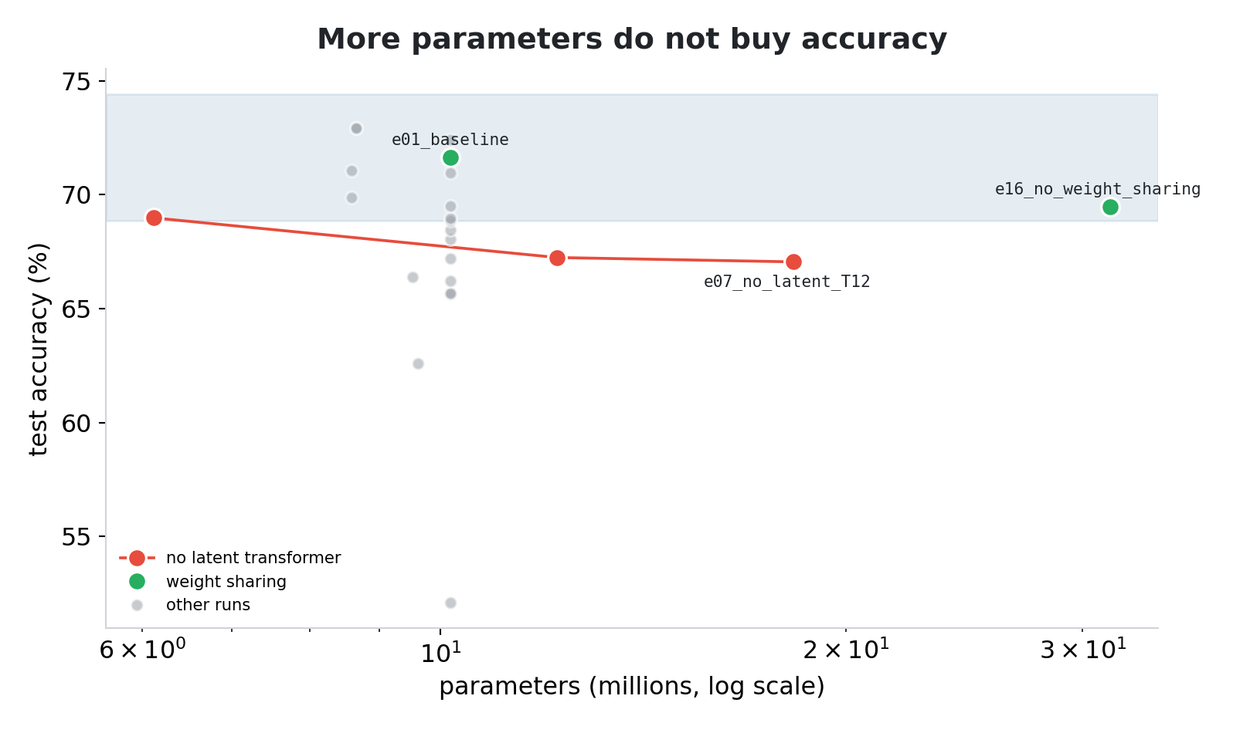
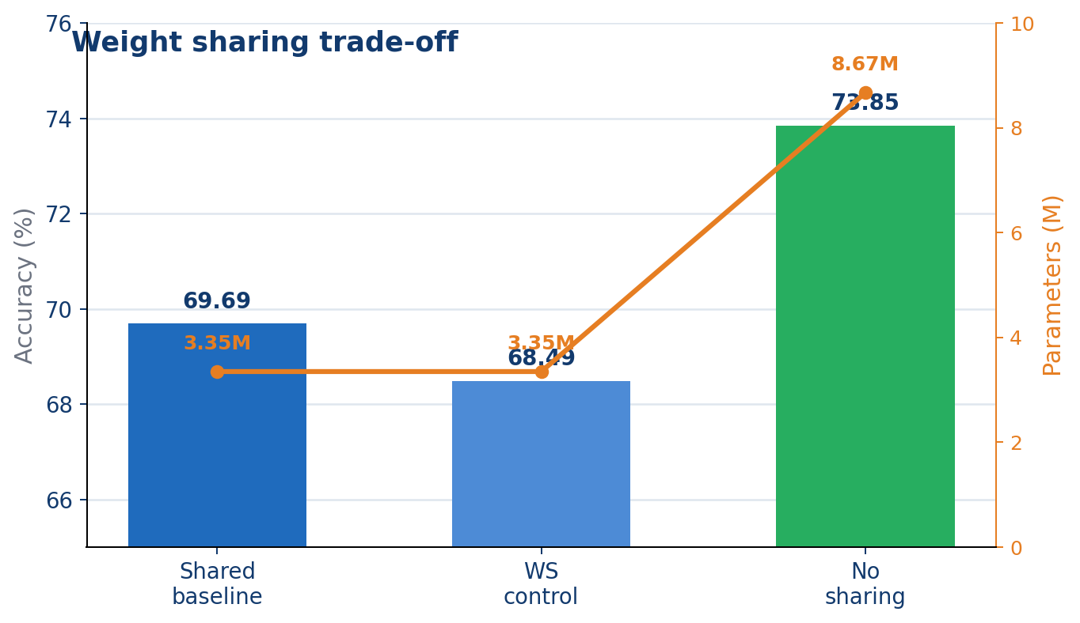
CIFAR-10: Weight Sharing Trade-off
Dropping weight sharing triples the parameter count and buys nothing measurable.
The trade-off, in numbers
What it means
• Shared, the baseline: 10.18M parameters, 71.63%
• Not shared: 31.46M parameters, 69.46% — 2.17 points lower
• Without the latent transformer at T=12: 18.29M, 67.05%
• Three times the parameters do not buy a point, and the difference sits inside the 2.78-point noise band
• Capacity is not what limits this model at CIFAR-10 scale
• Which is convenient: sharing is also what keeps memory affordable on a single GPU
F. Gigli C. Vignoli Perceiver & Perceiver IO

Slide 19
CIFAR-10: Fixed-Permutation Test
Train and evaluate on pixels shuffled by one fixed permutation σ — the same σ throughout.
Configuration | Acc.
Fourier PE, natural order (e01) | 71.63%
Fourier PE, permuted (e02) | 68.95%
Learned PE, natural order (e03) | 71.07%
Learned PE, permuted (e04) | 69.87%
What we measured
• Shuffling costs 2.68 points with Fourier features, 1.20 with a learned table
• Both sit inside the 2.78-point band, so neither is a measurable loss
The control that turns it into a claim
• Remove the encoding instead and accuracy collapses to 32.36%: a loss of 39.27 points
• So position does reach the model — through the encoding, never through the grid
• The learned-PE runs use a single cross-attend: a learned table is tied to one input layout
F. Gigli C. Vignoli Perceiver & Perceiver IO

Slide 20
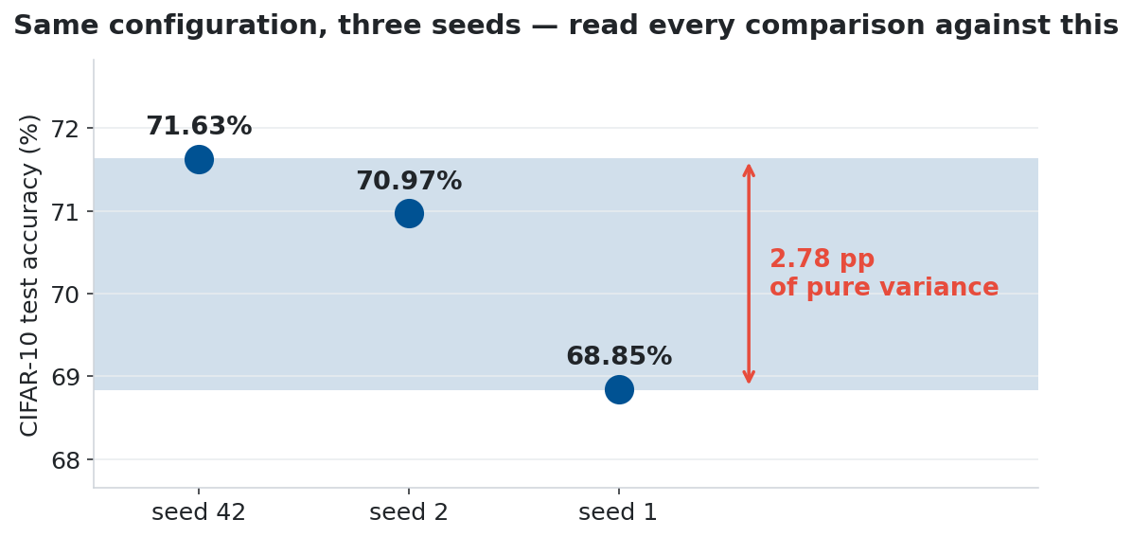
The Noise Band: What a Number Does on Its Own
Three runs, identical in everything but the seed, land 2.78 points apart. Read every other comparison against that.
The three runs
The rule this sets
• Seed 42 gives 71.63%, seed 2 gives 70.97%, seed 1 gives 68.85%
• Nothing else changed: same data, same schedule, same 120 epochs
• Any gap smaller than 2.78 points is variance, not an effect
• Twelve of the 24 CIFAR-10 runs clear the band; the other twelve are reported as inconclusive instead of dressed up as trends
• It cost two runs, and it changed the status of all the others
F. Gigli C. Vignoli Perceiver & Perceiver IO

Slide 21
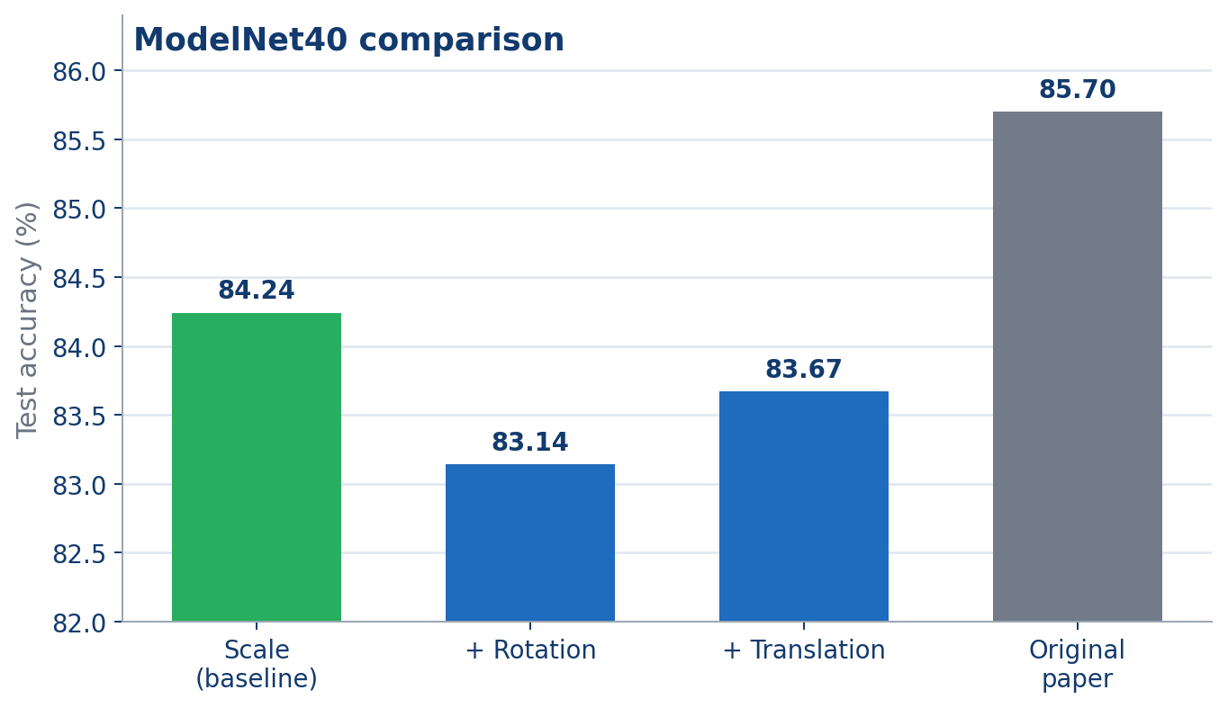
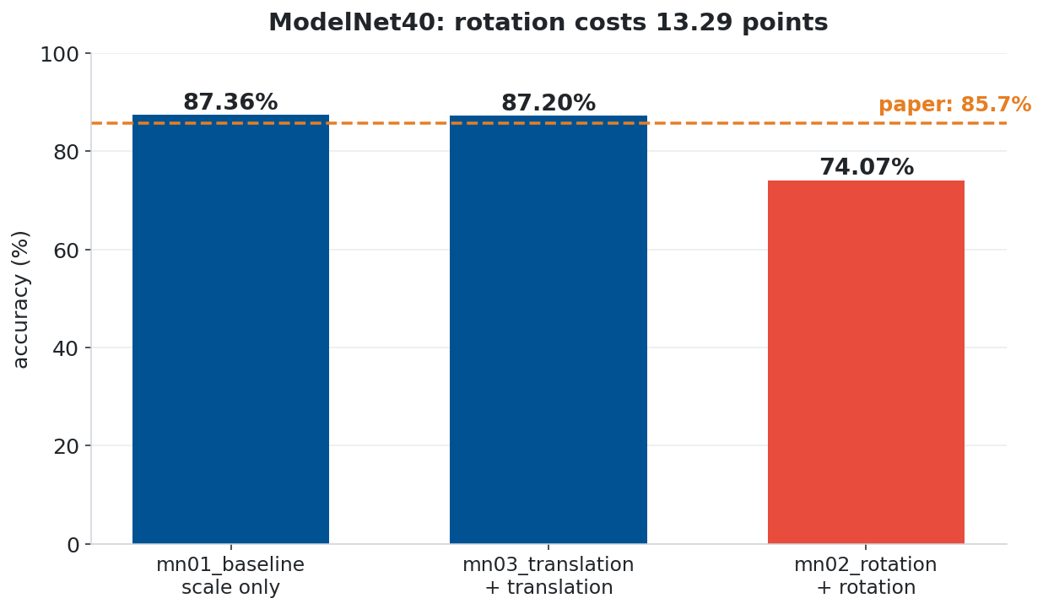
ModelNet40: Setup & Results
The same network, fed 2,048 points in 3D instead of pixels. Only the positional encoding changes dimension.
Hyperparameter | Value
Latent array (N × D) | 128 × 512
Cross-attn stages (T) | 2
Transformer blocks (L) | 6 (shared)
Points per object | 2,048
Optimizer / LR | LAMB · 0.001
Epochs | 120
Batch size | 32
Total parameters | 23.29M
What changed, and what did not
• The encoder is untouched: cross-attention into latents, a shared latent transformer, mean pooling
• The Fourier encoding becomes 3D, over (x, y, z) instead of (u, v)
• Nothing in the architecture knows it is looking at geometry
The result
• 87.36% against the paper's 85.7% — above it, with a batch sixteen times smaller
• ModelNet40 is small and its objects arrive canonically aligned, so the large-batch advantage that dominates ImageNet counts for little here
F. Gigli C. Vignoli Perceiver & Perceiver IO

Slide 22
ModelNet40: Augmentation Effects
Translation is free. Rotation costs 13.29 points — and the reason is the positional encoding again.
The three runs
Why rotation is different
• Scale only: 87.36%
• Plus translation: 87.20%, a loss of 0.16 points
• Plus rotation: 74.07%, a loss of 13.29
• ModelNet40 objects arrive canonically aligned, all facing the same way
• Random rotation destroys that alignment, and the 3D Fourier encoding of the coordinates with it
• Translation is harmless because the coordinates are re-centred anyway
F. Gigli C. Vignoli Perceiver & Perceiver IO

Slide 23
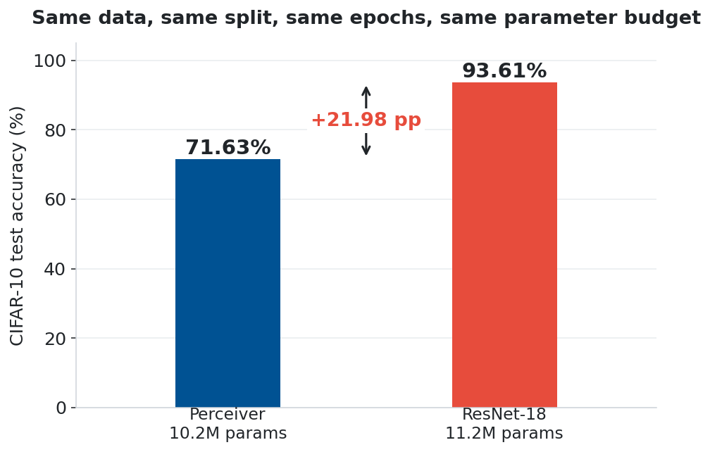
CIFAR-10: The Reference That Is Not a Perceiver
Neither Perceiver paper benchmarks CIFAR-10, so we trained the reference ourselves: a ResNet-18, same split, same epochs, same budget.
The comparison
What the gap measures
• The ResNet-18 reaches 93.61%; the Perceiver baseline reaches 71.63%
• That is 21.98 points, with 11.2M parameters against 10.2M
• On ImageNet the paper beats ResNet-50 by 4.5 points: the scale is the variable, not the architecture
• It never claimed accuracy — it claimed generality
• Here that prior costs 22 points; the paper says it stops paying at ImageNet scale
F. Gigli C. Vignoli Perceiver & Perceiver IO

Slide 24
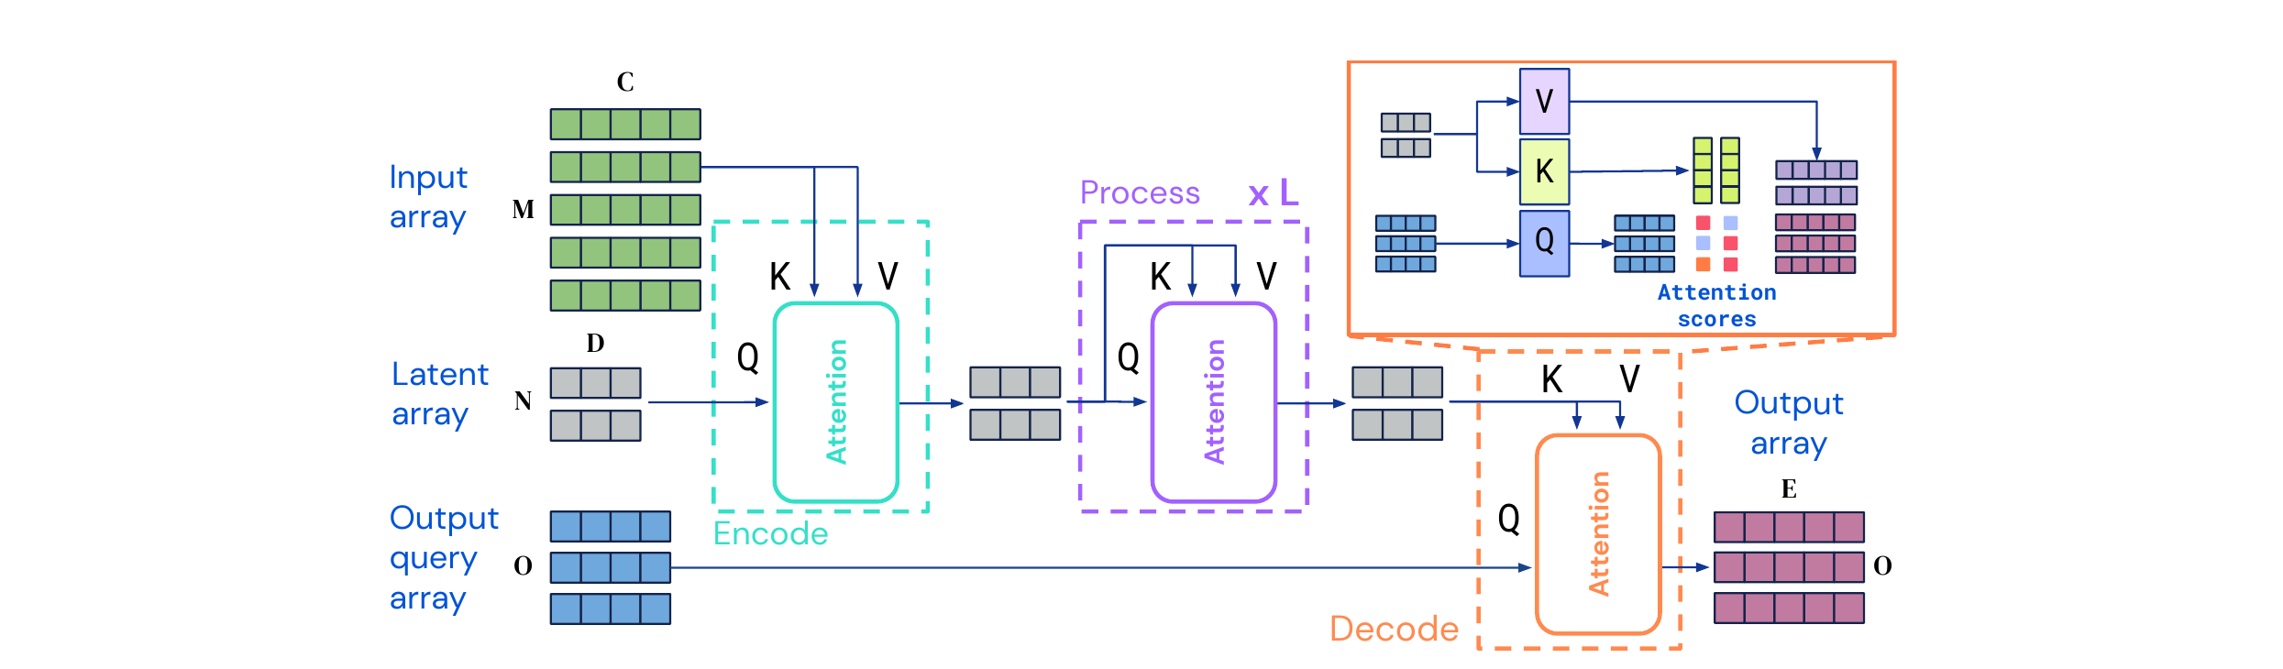
Perceiver IO: Structured Outputs
Perceiver IO keeps the same latent bottleneck and replaces the exit: instead of pooling, you ask the latents a question.
What changes
What stays
• The original Perceiver emits one pooled vector, so one global label
• Perceiver IO emits whatever shape the query array has
• The output size stops being an architectural constraint
• The encoder is the same: cross-attention into N latents, then a shared latent transformer
• The decoder costs one cross-attention layer, nothing more
F. Gigli C. Vignoli Perceiver & Perceiver IO

Slide 25
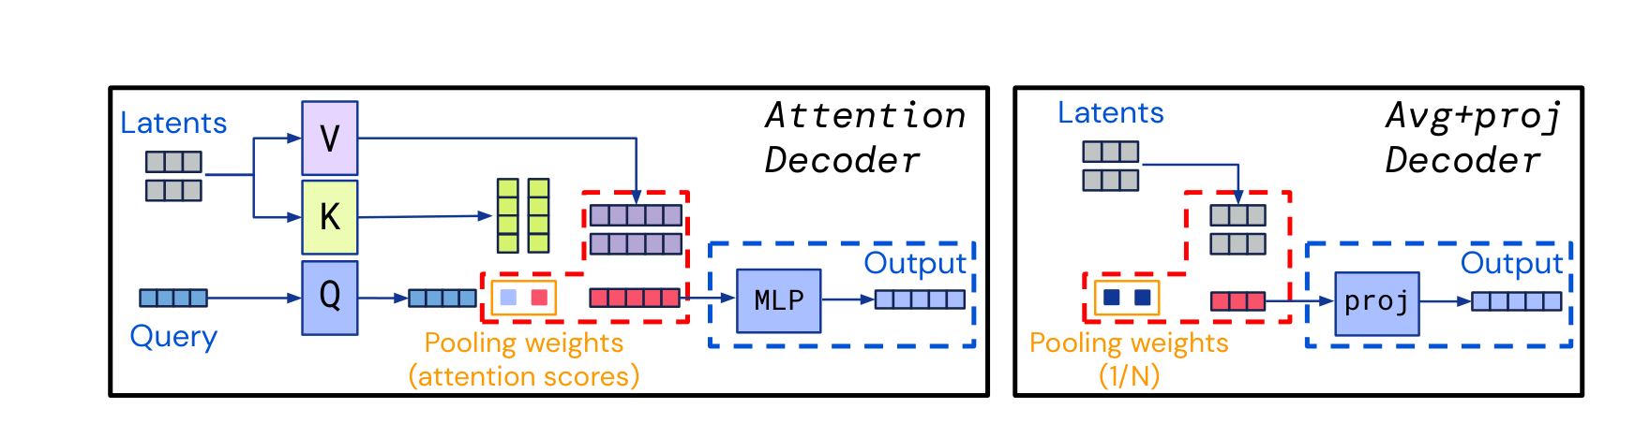
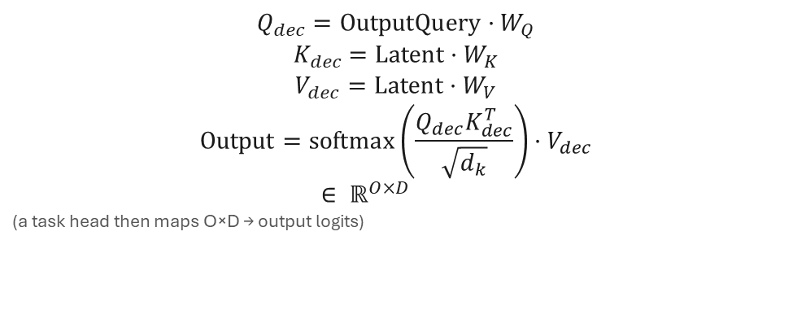
Perceiver IO Decoder with Output Queries
The decoder is one cross-attention layer: the queries come from the task, the keys and values from the latents.
$$Q_{dec}=\text{OutputQuery}·W_{Q}$$
$$K_{dec}=\text{Latent}·W_{K}$$
$$V_{dec}=\text{Latent}·W_{V}$$
$$\text{Output}=\text{softmax}\left(\frac{Q_{dec}K_{dec}^{T}}{\sqrt{d_{k}}}\right)·V_{dec}$$
$$∈ ℝ^{O×D}$$
(a task head then maps $O×D$ → output logits)
How it works
Why that matters
• The number of output queries O depends only on the task — not on N, not on M
• One cross-attention layer is enough, and there is no self-attention among the outputs
• The output shape becomes a design choice instead of an architectural constraint
• Adding a task means adding queries, not building another model
F. Gigli C. Vignoli Perceiver & Perceiver IO

Slide 26
Output Query Design per Task
All heads read the same final latent array $Z^{(L)}∈{\text{ℝ}}^{N×D}$ via decoder cross-attention.
Classification
Dense outputs
Masked LM
$O=1$​
$O=H×W$​
$O=M$​
→ class logits
→ dense output
→ token logits
One learned query produces a single global prediction.
The output shape is controlled directly by the query array.
One query per byte position; the loss is scored only where the input was masked.
F. Gigli C. Vignoli Perceiver & Perceiver IO

Slide 27
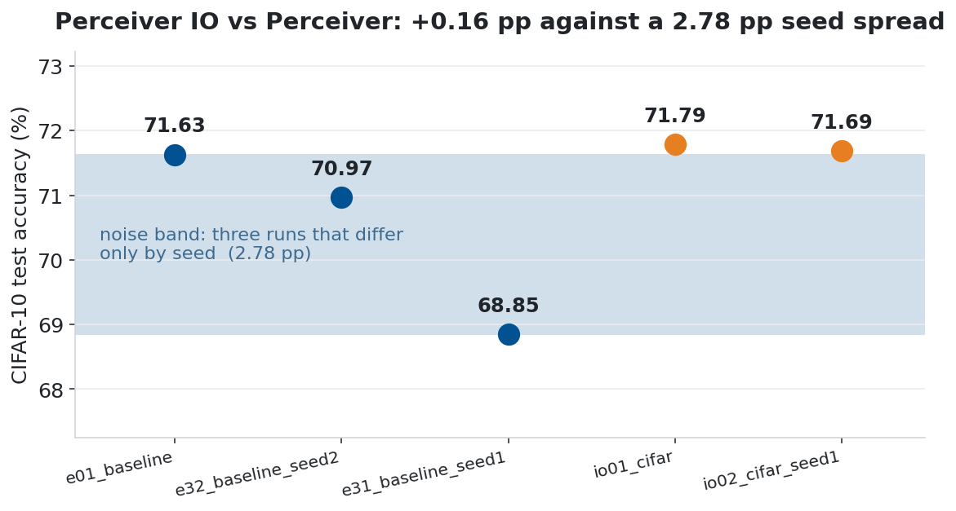
CIFAR-10: Perceiver vs Perceiver IO
On a single label out of ten, the query decoder and mean pooling are the same thing — and the measurement says so.
What the decoder does differently
What it is worth here
• The output query is a learned aggregation instead of a fixed average
• It cross-attends to the latents, so it can weight them unequally
• 71.79% against 71.63%: 0.16 points, a fraction of the 2.78-point seed spread
• And it costs 12.05M parameters against 10.18M
• The decoder earns its place on the MLM and on dense outputs, not on this task
F. Gigli C. Vignoli Perceiver & Perceiver IO

Slide 28
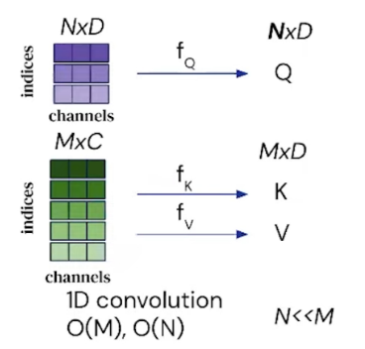
WikiText-103: Masked Language Model Pre-training
Pre-train a language encoder with no tokenizer at all: the input is the raw UTF-8 byte stream.
Component | Detail
Tokenization | Byte-level UTF-8, no tokenizer
Vocabulary size | 256
Sequence length | 512
Mask probability | 15%
Latent array (N × D) | 128 × 512
Model | Perceiver IO, 18.87M params
Epochs / batch | 10 / 32
Masked-byte accuracy | 86.68%
Chance level | 0.39% (1 / 256)
Why bytes
• No BPE or WordPiece vocabulary to build, and nothing language-specific in the input
• The vocabulary is fixed at 256 — every byte value there is
• The price is length: the same text takes about four times more tokens
The task, and the result
• 15% of the byte positions are masked, with one output query per position
• The decoder predicts the original byte, one of 256
• 86.68% correct against a chance level of 0.39% — about 222 times better than guessing
F. Gigli C. Vignoli Perceiver & Perceiver IO

Slide 29
GLUE: Fine-tuning on 8 Tasks
The same encoder, the same weights, one query swapped. Eight tasks, eight fine-tunings.
How the fine-tuning runs
The eight tasks
• The encoder is loaded from the MLM checkpoint; if it is missing the code stops instead of pretending
• The query array is replaced by a single classification query
• LAMB at 5 × 10⁻⁴ with a cosine schedule
• The epoch budget follows task size: 3 epochs for 393k examples, 30 for 2.5k
• The input stays byte-level at sequence 512, identical to pre-training
• Single sentence — CoLA judges grammatical acceptability, SST-2 sentiment
• Similarity — MRPC and QQP ask whether two sentences mean the same, STS-B by how much
• Inference — MNLI, QNLI and RTE ask whether one sentence follows from another
• Each probes a different ability, and the architecture never changes
F. Gigli C. Vignoli Perceiver & Perceiver IO

Slide 30
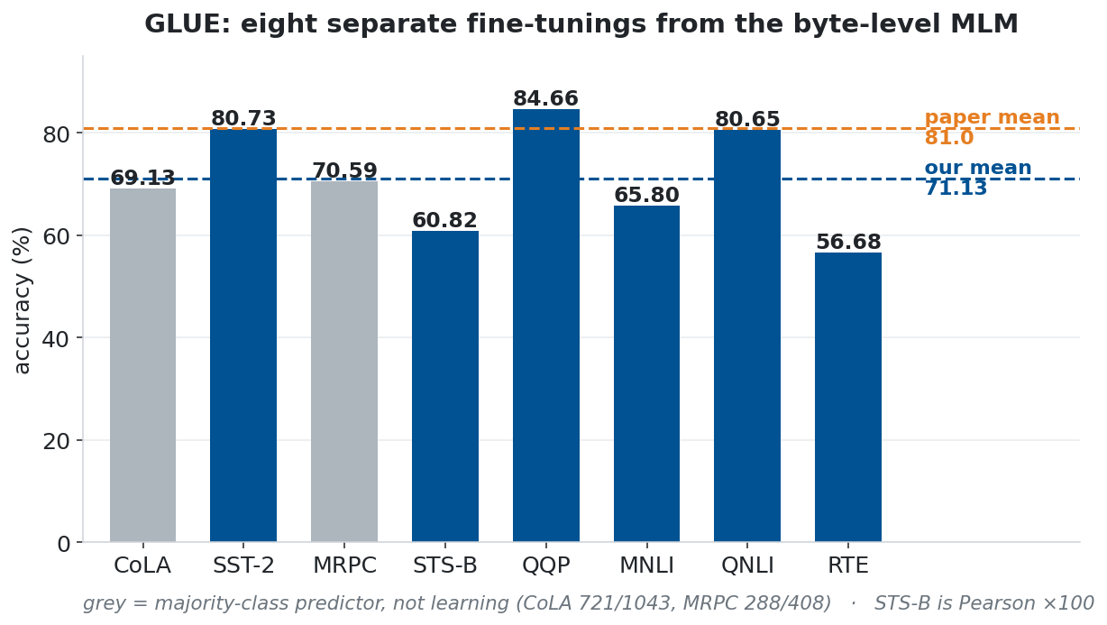
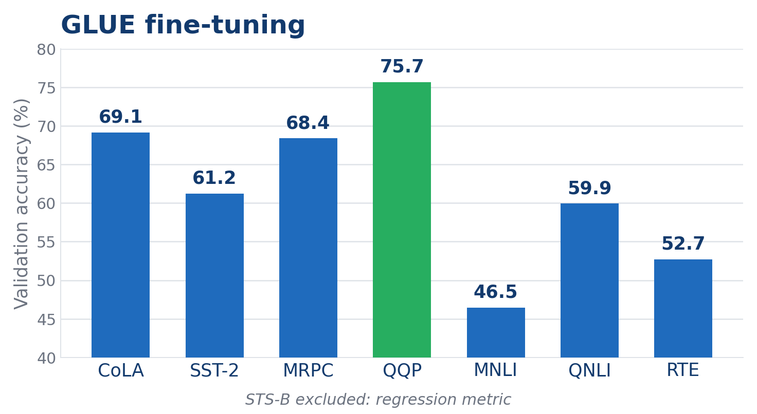
GLUE: Per-Task Results
The mean over the eight tasks is 71.13 against the paper's 81.0 — and two of the eight numbers are not learning at all.
What the runs say
Why the level sits below the paper
• QQP is the strongest at 84.66%, RTE the weakest at 56.68%
• CoLA scores exactly the majority-class count, 721 of 1,043; MRPC beats its majority by nine examples out of 408
• So the mean rests on six tasks, not eight
• 18.9M parameters pre-trained on WikiText-103, against 201M on Wikipedia and C4
• Byte-level input, with no subword tokenizer to lean on
• STS-B is reported as Pearson × 100, the official GLUE metric
F. Gigli C. Vignoli Perceiver & Perceiver IO

Slide 31
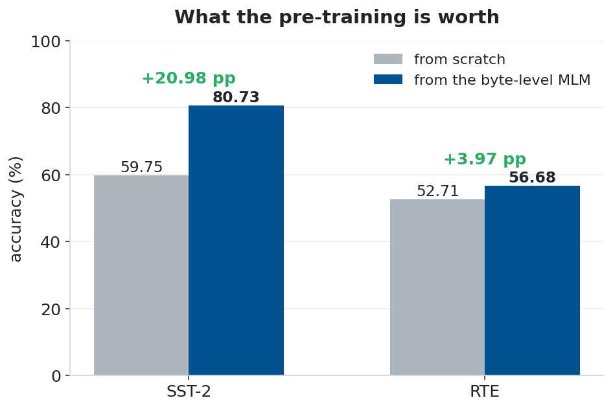
GLUE: What the Pre-training Is Worth
Two tasks fine-tuned twice — once from the MLM checkpoint, once from random weights. Everything else identical.
Why only two controls
And the prediction holds
• A fine-tuned 80% means nothing on its own: the task might be solvable at 80% from scratch
• The two are chosen at the extremes of data size — SST-2 has 67,000 examples, RTE has 2,500
• SST-2 goes from 59.75% to 80.73%, a gain of 20.98 points
• RTE goes from 52.71% to 56.68%, a gain of 3.97
• Transfer is worth five times more where the data abounds: 2,500 examples cannot exploit the encoder they were handed
F. Gigli C. Vignoli Perceiver & Perceiver IO

Slide 32
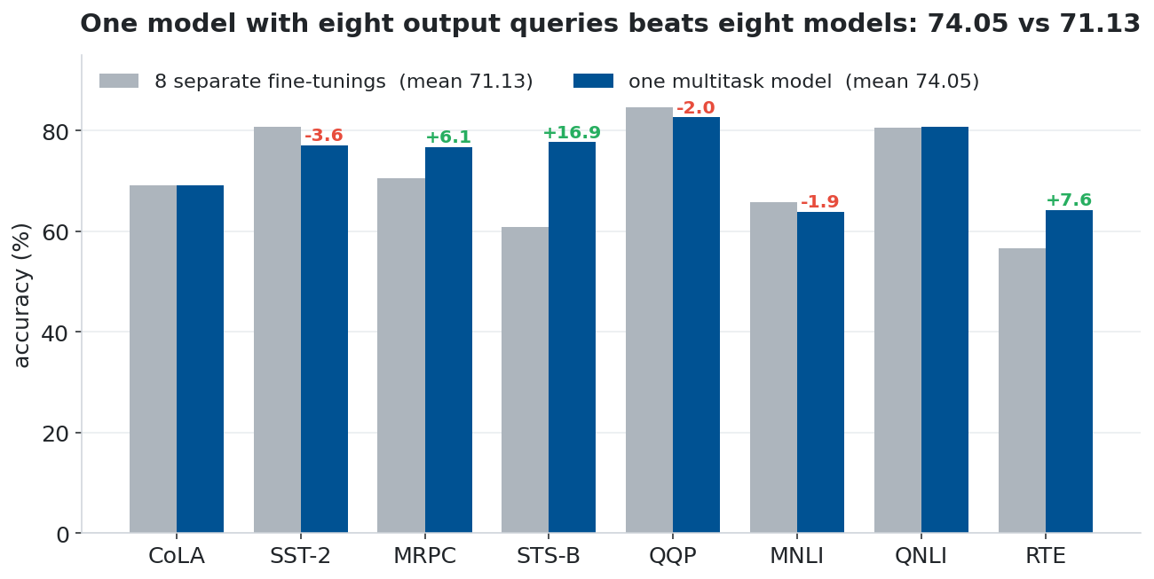
GLUE Multitask: One Model, Eight Output Queries
One model with eight output queries against eight separate fine-tunings — the comparison from Table 2 of the IO paper.
What replicates
Why the win is understated
• The paper measures 81.8 against 81.0, a gain of 0.8; here 74.05 against 71.13, a gain of 2.92
• The absolute level stays about eight points below and does not close
• But sign and order of magnitude hold, and that relation is what Table 2 claims
• The multitask model picks one epoch for all eight tasks; the separate models pick eight
• It wins anyway
• And a ninth task would cost one query, not another model
F. Gigli C. Vignoli Perceiver & Perceiver IO

Slide 33
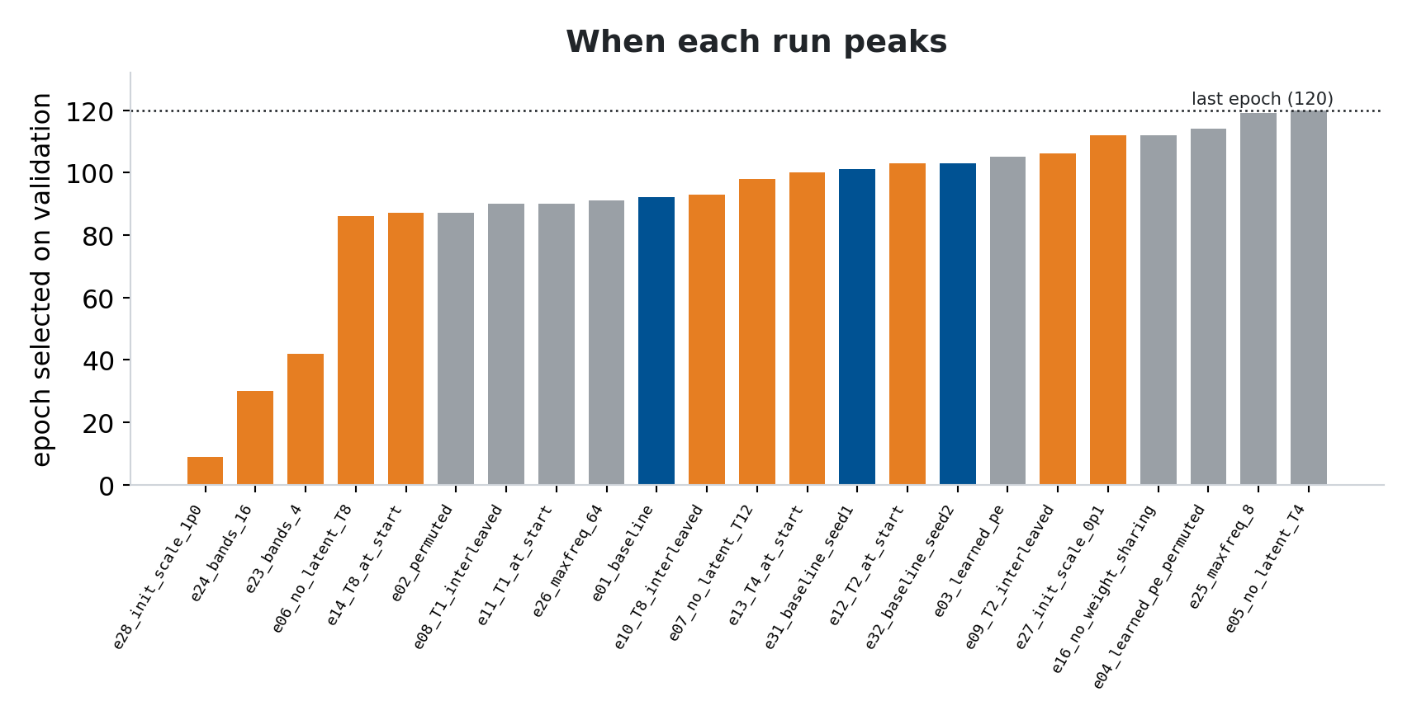
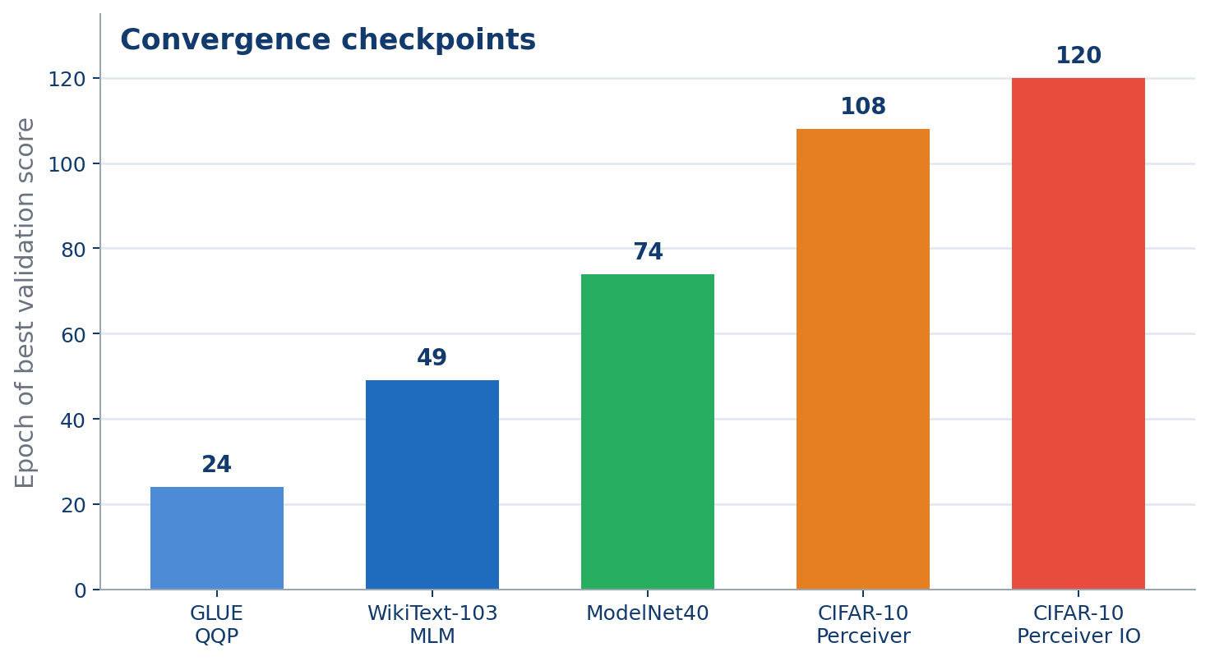
Convergence: Representative Checkpoints
There is no early stopping: every run trains the full schedule and reports the checkpoint that was best on validation.
When each run peaks
What an early peak actually means
• Fine-tuning peaks within a handful of epochs: SST-2 at 7, the MLM at 10
• Image training uses almost the whole 120-epoch schedule: the Perceiver at 92, ModelNet at 94, the ResNet at 117
• It is a collapse, not fast convergence: e28 peaks at epoch 9 and never recovers
• e23 peaks at 42 with 67.74% on validation and ends the run at 22.54%
• The reported number still comes from the checkpoint chosen on validation, but the instability has to be declared
F. Gigli C. Vignoli Perceiver & Perceiver IO

Slide 34
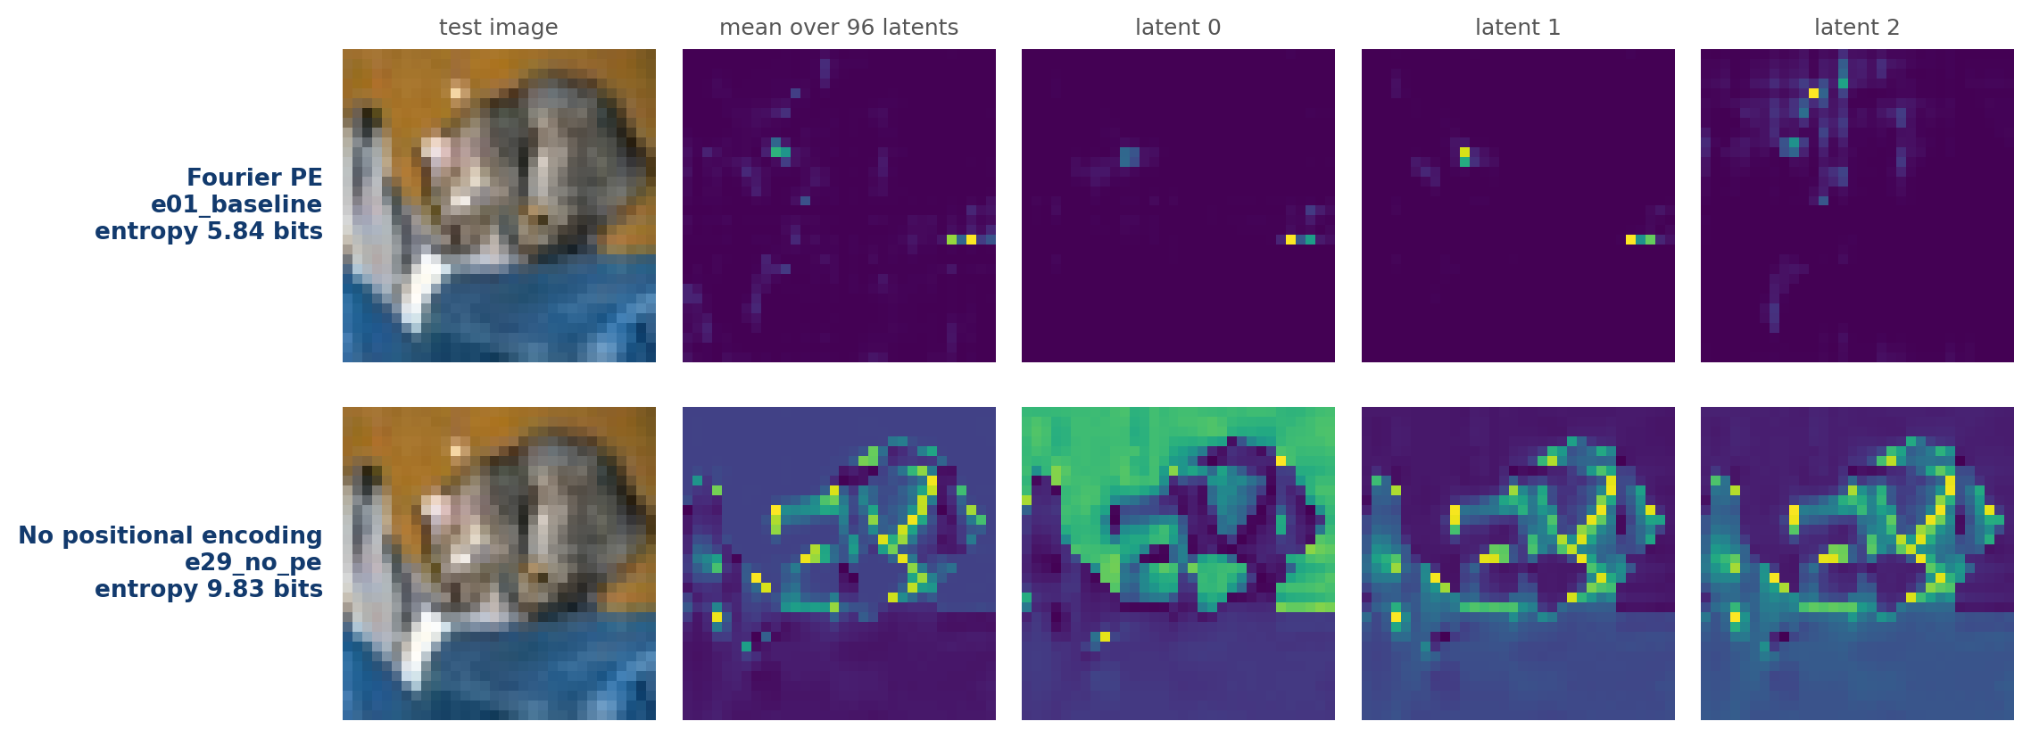
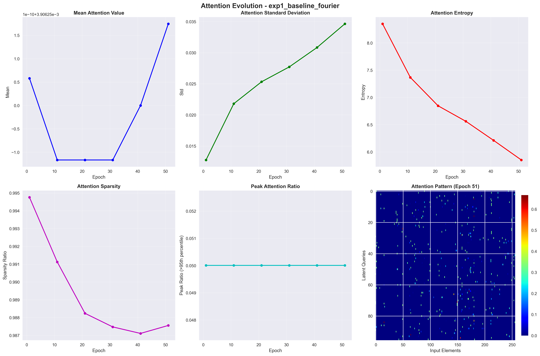
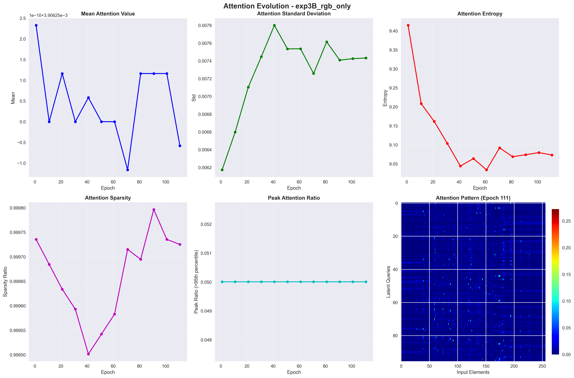
Attention Maps: Where the Latents Look
With coordinates the latents pick locations; without, they can only pick colours.
Fourier PE (e01, 71.63%)
No PE (e29, 32.36%)
• Each latent attends to a few pixels at specific locations
• Mean entropy 5.84 bits over 1,024 pixels (uniform: 10 bits)
• Same-colour pixels are indistinguishable: attention follows colour boundaries
• 9.83 bits, 98% of uniform — spread over the whole image
F. Gigli C. Vignoli Perceiver & Perceiver IO

Slide 35
Comprehensive Results Summary
Forty-two runs, all completed. Every number below traces to a results.json — none is quoted from memory.
Modality | Model | Best result | Reference | Runs
Images (CIFAR-10) | Perceiver | 72.91% | 93.61% ResNet-18 | 24
Images (CIFAR-10) | Perceiver IO | 71.79% | — | 2
Point clouds (ModelNet40) | Perceiver | 87.36% | 85.7% paper | 3
Text (WikiText-103) | Perceiver IO | 86.68% MLM | 0.39% chance | 1
NLU (GLUE, 8 tasks) | Perceiver IO | 71.13 mean | 81.0 paper | 11
What is measured
The scope of the campaign
• ModelNet40 beats the paper by 1.66 points
• The byte-level MLM reaches 86.68% against a 0.39% chance level
• One multitask model beats eight separate ones, 74.05 against 71.13
• 42 runs in a declarative registry, all of them completed
• Three modalities: 2D images, 3D point clouds, raw bytes
• 53 tests passing, and a 2.78-point noise band measured before any comparison was read
F. Gigli C. Vignoli Perceiver & Perceiver IO

Slide 36
Gap vs Original Papers
On the modality with the weakest domain prior we beat the paper. On the one with the strongest, a convolutional net of the same size beats us.
Source | Acc.
Original paper | 85.70%
This implementation | 87.36%
Difference | +1.66 pp
Source | Acc.
ResNet-18, same budget | 93.61%
This Perceiver | 71.63%
Difference | -21.98 pp
ModelNet40 — point clouds
CIFAR-10 — images
• 85.70% in the paper, 87.36% here: 1.66 points above it
• With a batch sixteen times smaller. The dataset is small and canonically aligned, so the large-batch advantage counts for little
• 93.61% for a ResNet-18 on the same budget, 71.63% for the Perceiver: 21.98 points below
• The paper does not benchmark CIFAR-10, so the reference had to be measured rather than quoted
On ImageNet the paper beats ResNet-50 by 4.5 points: the prior stops paying at scale, and that relation is the claim being replicated.
F. Gigli C. Vignoli Perceiver & Perceiver IO

Slide 37
Hardware Limitations & Design Choices
Every limitation below is one GPU instead of 512 TPU cores. The architecture is the paper's; the budget is not.
Parameter | Original paper (Google) | This project
Hardware | 512 TPU v3 cores | 1 NVIDIA RTX 3080
Batch size | up to 1024 | 32–64
Latents (N) | 256–512 | 96 (images) · 128 (point clouds, text)
Model size | 30–200M+ params | 10.2–23.3M params
Pre-training corpus | Wikipedia + C4 (201M-param IO) | WikiText-103 (18.9M-param IO)
What it cost us
What we did about it
• LAMB was built for large batches; at 64 it is sensitive to the latent init scale
• Fewer latents mean less representational capacity
• Half the CIFAR-10 ablations land inside the noise band
• The GLUE level stays about ten points below the paper
• Weight sharing to cut memory — and it costs nothing measurable
• Three seed replicas, to measure the noise before reading any effect
• An epoch budget scaled per task size on GLUE, from 3 to 30
• A convolutional baseline, so the numbers can be read at all
F. Gigli C. Vignoli Perceiver & Perceiver IO

Slide 38
Possible Improvements
What we would do next, in rough order of how much it would move the numbers.
Architecture
Training
Data and tasks
Analysis
• More latents (N = 256+) with gradient checkpointing
• Multi-scale cross-attention, coarse to fine
• Relative position encodings such as RoPE or ALiBi
• A deeper decoder for structured outputs
• Larger effective batches via gradient accumulation
• More seeds per ablation, to narrow the 2.78-point band
• Longer schedules
• Stronger augmentation: CutMix, MixUp
• ImageNet pre-training for vision
• Longer byte-level pre-training: more epochs, larger corpus
• Joint multi-modal training
• An audio modality
• Layer-wise attention probing
• Clustering the latent space
• A systematic hyperparameter search
• A comparison with Linformer and Performer
F. Gigli C. Vignoli Perceiver & Perceiver IO

Slide 39
Empirical Summary
Everything measured, split by whether it survived the noise band.
What worked
What did not
• One architecture across images, point clouds and raw bytes
• ModelNet40 above the paper: 87.36% against 85.7%
• The byte-level MLM works: 86.68% against a 0.39% chance level
• Pre-training transfers: SST-2 from 59.75% to 80.73%
• One multitask model beats eight separate ones: 74.05 against 71.13
• A ResNet-18 on the same budget reaches 93.61% against 71.63%
• The latent init scale destabilises training: at 1.0 the run collapses to 52.08%
• Two GLUE numbers are the majority class, not learning
• Byte-level input means very long sequences for the same text
• Twelve of the 24 CIFAR-10 runs are indistinguishable from noise
Removing the positional encoding is the largest effect measured: 71.63% to 32.36%. Permuting the pixels costs 2.68 points, inside the band. Position enters through the encoding, not the grid.
F. Gigli C. Vignoli Perceiver & Perceiver IO

Slide 40
Conclusions
What the architecture gives, and what it still costs at this scale.
What it gives
What it costs
• One architecture for images, point clouds and text
• Complexity linear in the input size
• Weight sharing: three times fewer parameters at no measurable cost
• No CNN or RNN assumptions about the domain
• Output queries: one more task costs one query, not another model
• At this scale the domain prior is worth 21.98 points
• Everything depends on the positional encoding: 39.27 points without it
• GLUE sits about ten points below the paper, at a tenth of the parameters and pre-training
• LAMB at batch 64 is sensitive to the latent init scale
• Half the image ablations cannot be told apart from noise
The Perceiver's advantage is not accuracy — it is having no prior on the domain. At CIFAR-10 scale that prior is worth 22 points; the paper's own claim is that it stops paying at ImageNet scale.
F. Gigli C. Vignoli Perceiver & Perceiver IO

Slide 41
Thank you!
Questions?
Francesco Gigli · Corso Vignoli
Università degli Studi di Firenze · Course B031278 — Deep Learning
Code and reproduction instructions shared with the course

